Slide 1
INTRODUCTION TO KATALON STUDIO Streamline Your Test Automation Process
Presented By:
Naveen Kumar Patti
Consultant

Slide 2


Slide 3
Agenda
01 Overview of Katalon Studio
06 Execution of scripts
02 How to Start?
07 Test Suite/Reports
03 Katalon Studio Workflow
08 Katalon Studio – Other Key features
04 How to create a Framework
19 References
05 Creating the reusable methods
10 Live Demo

Slide 4

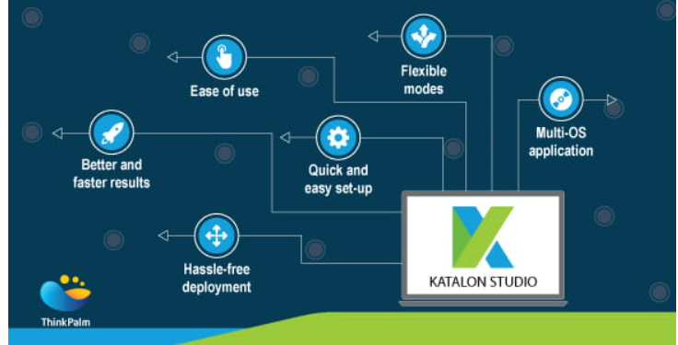
Overview of Katalon Studio
Key Features
Support for multiple scripting languages (Java, Groovy)
Built-in keywords and plugins
Integration with various testing frameworks (JUnit, TestNG)
Support for web, API, and mobile automation
User-friendly interface Ease of use
Cost-effectiveness compared to other test automation tools
Extensive documentation and tutorials
Dedicated customer support

Slide 5
Use Cases and Benefits
Use Cases:
Web application testing
API testing
Mobile testing
Benefits:
Faster test script development
Cross-browser and cross-platform compatibility testing
Reusability of test scripts
Comprehensive test reporting and analysis
Seamless integration with CI/CD pipelines

Slide 6
How to Start?
Download Katalon Studio:
Visit the Katalon website (https://www.katalon.com/) and navigate to the "Downloads" section.
Choose the appropriate version of Katalon Studio based on your operating system (Windows, macOS, or Linux).
Click on the download link to start downloading the installation file.
Install Katalon Studio:
Once the download is complete, locate the downloaded installation file on your computer.
Double-click the installation file to start the installation process.
Follow the on-screen instructions to complete the installation of Katalon Studio.
Launch Katalon Studio:
After the installation is complete, locate the Katalon Studio icon on your desktop or in the installation directory.
Double-click the Katalon Studio icon to launch the application.
Activate Katalon Studio (Optional):
If you have a Katalon account and license, you can activate Katalon Studio by signing in with your credentials.
If you don't have a license, you can start with the free version of Katalon Studio by choosing the "Free mode" option.
Get Started:
Once Katalon Studio is launched, you can start creating your first project by clicking on the "New Project" button.

Slide 7
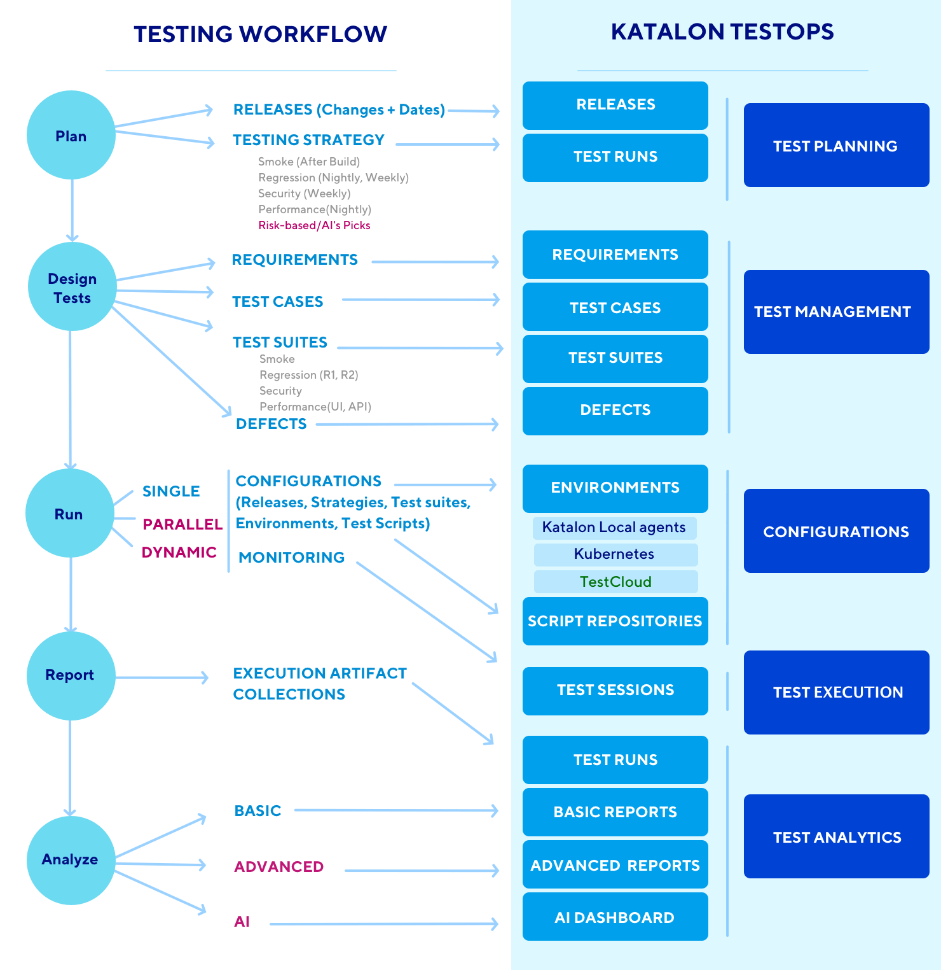
Katalon Studio Workflow
.

Slide 8
Creating Web recording

Slide 9
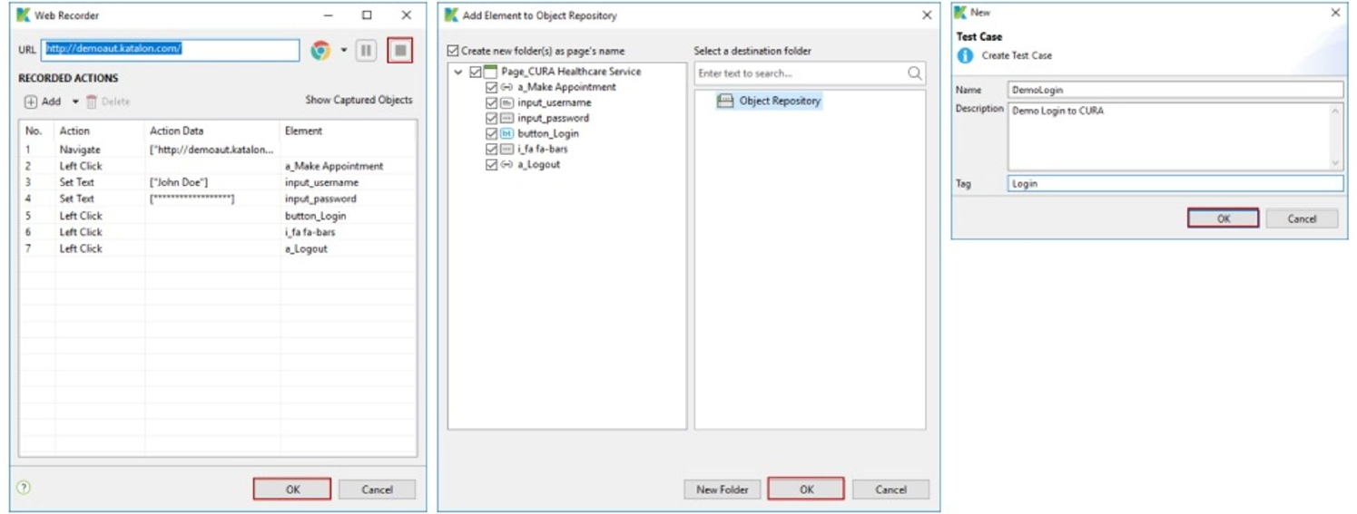
Stop web recording

Slide 10
Creation of Framework
Creating a framework in Katalon Studio involves organizing your test automation artifacts (test cases, test suites, objects, data files, etc.) in a structured and reusable manner. Create a New Project:
Launch Katalon Studio and click on the "New Project" button.
Choose a location to save your project and specify its name.
Select a template (Web, Mobile, API) based on the type of testing you want to perform.
Click "OK" to create the project.
Define Folder Structure:
Inside your project, define a folder structure to organize your test artifacts. Common folders include:
Test Cases: Store individual test cases here.
Test Suites: Store collections of test cases (test suites) here.
Test Objects: Store test objects (locators) here.
Keywords: Store custom keywords (reusable actions) here.
Data Files: Store test data files (e.g., Excel, CSV) here.
Reports: Store test execution reports here.
Configurations: Store environment configurations (URLs, credentials) here.
Create Test Cases:
Create individual test cases for different test scenarios.
Use a modular approach to design test cases, focusing on reusability and maintainability.
Leverage built-in keywords and custom keywords to perform actions and validations.

Slide 11
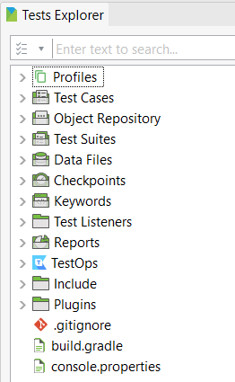
CREATION OF FRAMEWORK
3.Create Test Suites:
Create test suites to group related test cases based on test scenarios or features.
Define execution profiles to specify different environments (e.g., Chrome, Firefox).
4.Manage Test Objects:
Create and organize test objects to represent UI elements in your application.
Use descriptive names and properties to uniquely identify test objects.
Store test objects in the Test Objects folder and reuse them across test cases
5.Implement Data-Driven Testing:
Use data files (e.g., Excel, CSV) to parameterize your test cases and execute them with different input data.
Create test data files and store them in the Data Files folder.
Use data binding to associate test data with test cases.
6.Customize Reporting:
Configure custom reporting options to generate detailed and informative test execution reports.
Customize report templates and settings based on your project requirements.

Slide 12
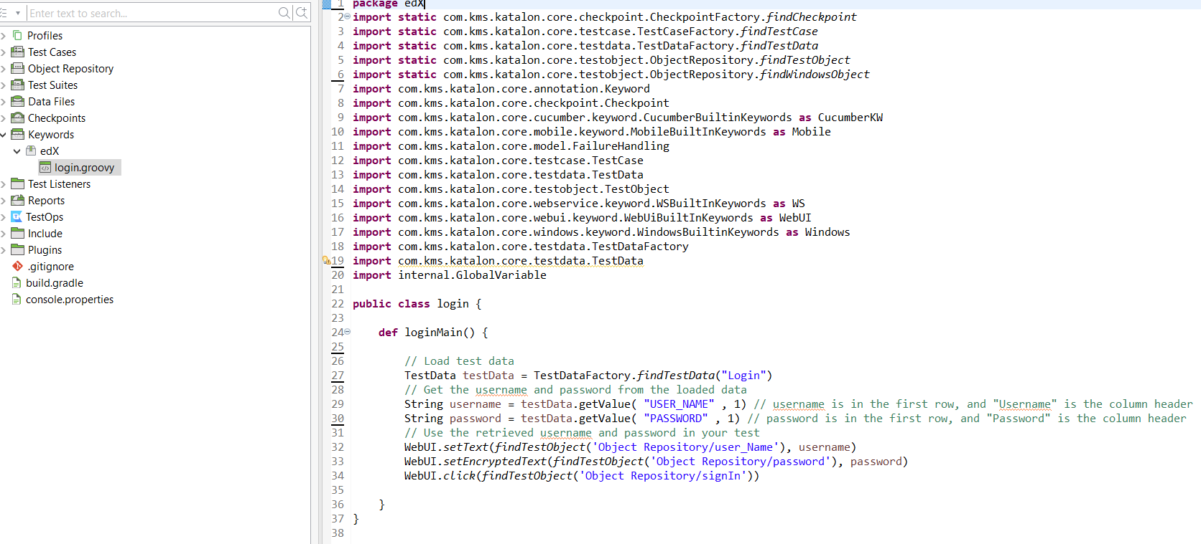
Creation of Reusable Methods
To create reusable methods in Katalon Studio:
1. Navigate to the "Keywords" folder and create a new custom keyword.
2. Define the method in the Script Editor using Groovy or Java.
3. Use the custom keyword in test cases to encapsulate and reuse common actions.

Slide 13
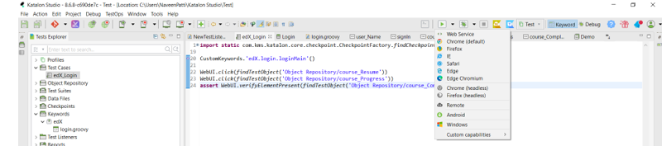
Execution of Scripts
To execute scripts in Katalon Studio:
Open Katalon Studio and navigate to your project.
Select the test case or test suite you want to execute.
Click on the "Run" button to execute the selected test artifact. Adjust execution settings as needed before running.

Slide 14
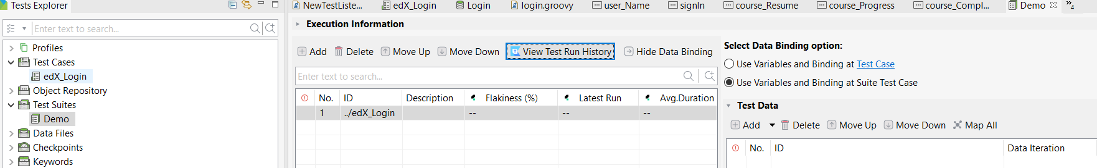
Test Suite
Create Test Suite:
In Katalon Studio, navigate to the "Test Suites" folder within your project.
Right-click on the folder and select "New > Test Suite."
Give your test suite a name and click "OK" to create it.
Double-click on the test suite to open it.
Add Test Cases:
In the Test Suite Editor, click on the "+" icon to add test cases to the suite.
Select the test cases you want to include from the list and click "OK" to add them.
Arrange the order of the test cases as needed by dragging them up or down in the list.
Configure Execution Settings:
In the Test Suite Editor, configure the execution settings for the test suite.
Choose the execution profile (e.g., browser) and other options such as parallel execution, retry settings, etc.
Optionally, configure any data-driven testing settings if your test cases require data binding.
Execute Test Suite:
Click on the "Run" button in the Test Suite Editor to execute the test suite.
Katalon Studio will execute the test cases in the specified order according to the configured settings.
Monitor the progress of the test suite execution in the Console tab.

Slide 15
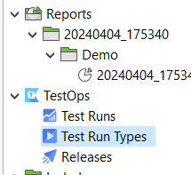
Test Reports
View Reports:
After the test suite execution is complete, navigate to the "Reports" folder within your project.
Open the latest report file to view detailed test execution results.
The report provides information such as test case status, duration, logs, and screenshots for each executed test case.
Customize Reports:
Katalon Studio provides options to customize the format and content of test execution reports.
You can configure report settings in the Project Settings > Reports section to include or exclude specific information.
Additionally, you can customize report templates using HTML/CSS to tailor the appearance of the reports to your requirements.

Slide 16
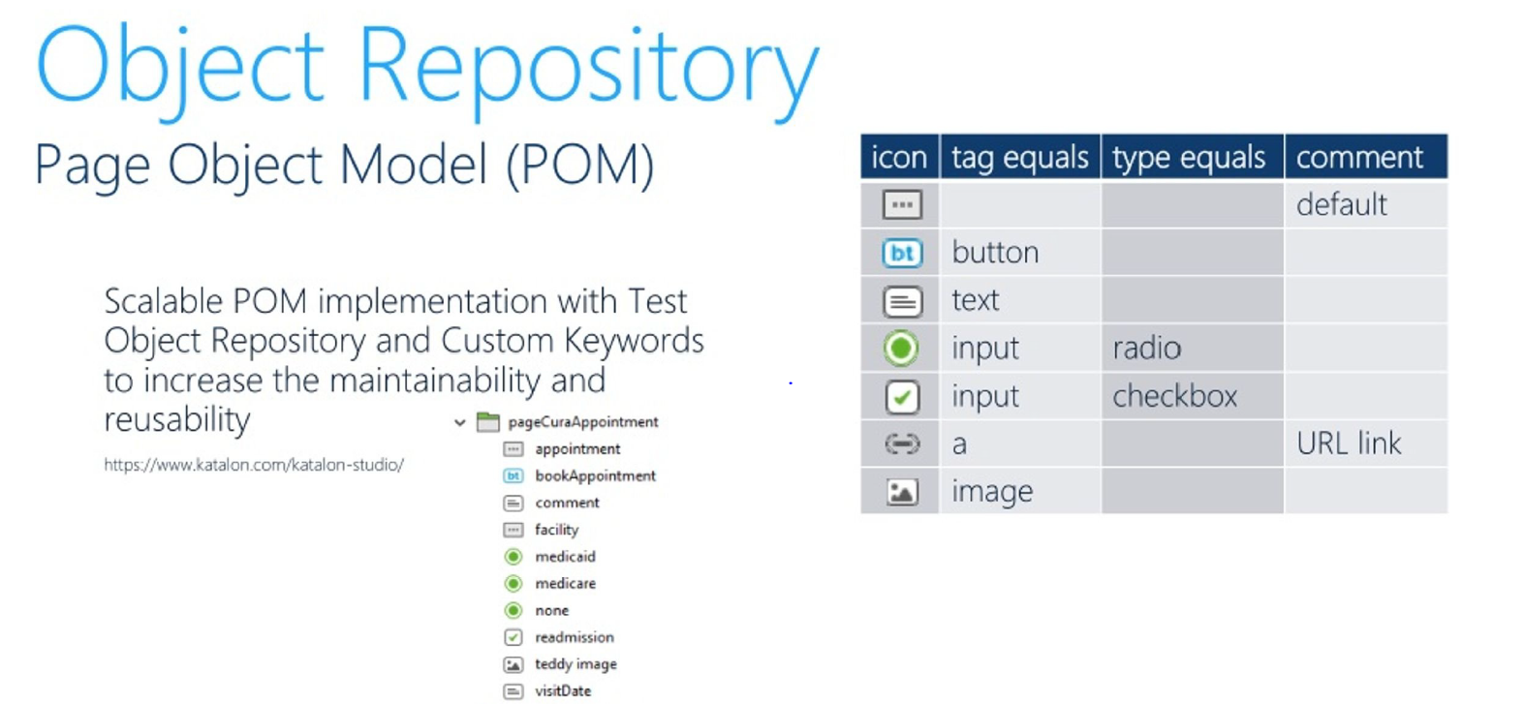
Other Key Features

Slide 17
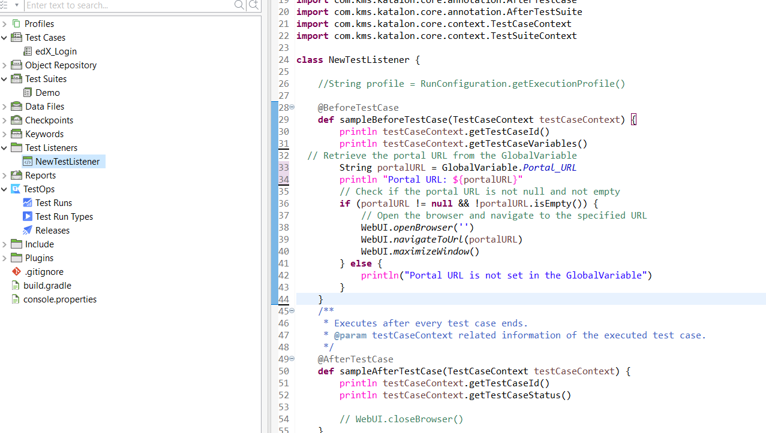
Test Listeners
Test listeners allows to execute custom code before or after specific test execution events, such as test case start or completion. By implementing listener methods within test listeners, providing greater flexibility and control over test execution.

Slide 18
References
Katalon Documentation: Including installation, getting started guides, tutorials, and detailed feature descriptions. Katalon Docs
Katalon Forum: A community-driven forum where users can ask questions, share knowledge, and seek help from fellow Katalon users and experts. Katalon Community - Katalon's Official Discussion Forum
Katalon YouTube Channel: Official YouTube channel featuring video tutorials, webinars, and tips for using Katalon Studio effectively. Mark's Spring 2024 - Made to be lived in - 15s Footwear (youtube.com)
Katalon Blog: Official blog featuring articles, tutorials, and best practices for test automation, continuous testing, and Agile practices.
The Katalon Blog

Slide 19


Slide 20


Slide 21



